Slide 1
Mental Representations
Ori Hacohen
14.12.2016

Slide 2
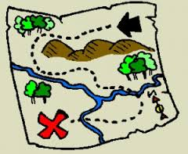
Representations
Intentionality - “aboutness”
Semantics / Content / Information

Slide 3
Representations
Play a causal role in explaining various phenomena
DANGER

Slide 4
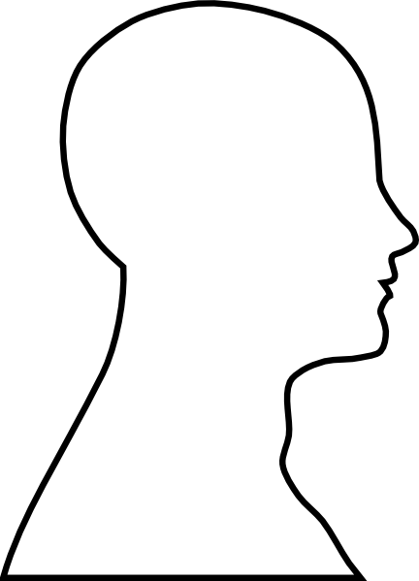
Mental Representations
Mental representations are content-bearing mental states or structures.
DANGER
FLEE

Slide 5
Representationalism vs. Eliminativism
“There are two major traditions in modern theorizing about the mind, one that we’ll call ‘representationalist’ and one that we’ll call ‘eliminativist.’ Representationalists hold that postulating representational (or ‘intentional’ or ‘semantic’) states is essential to the theory of cognition; according to representationalists, there are states of the mind which function to encode states of the world. Eliminativists, by contrast, think that psychological theories can dispense with such semantic notions as representation. According to eliminativists, the appropriate vocabulary for psychological theorizing is neurological or, perhaps behavioral, or perhaps syntactic; in any event, not a vocabulary that characterizes mental states in terms of what they represent.”
(Fodor & Pylyshin, 1988, p.7)

Slide 6
Representationalism
Basic Intuition
Folk Psychology
Cognitive Psychology
Computational Models
Neurological Studies

Slide 7
Exemplar Theory of Concepts

Slide 8
Representationalism
Basic Intuition
Folk Psychology
Cognitive Psychology
Computational Models
Neurological Studies

Slide 9
Edge Detection
light intensities

Slide 10
Representationalism
Basic Intuition
Folk Psychology
Cognitive Psychology
Computational Models
Neurological Studies
“[…] contemporary cognitive science has been squarely on the side of the representationalists" (Chemero, 2009, p. 20).
Hubel, D. H., & Wiesel, T. N. (1962).
Receptive fields, binocular interaction and functional architecture in the cat's visual cortex.
The Journal of physiology, 160(1), 106-154.

Slide 11
Eliminativism
Non-representational models (e.g. Radical Embodied Cognition- Chemero 2009, Hutto & Myin 2013).
Representationalism requires natural/original representation
DANGER
FLEE
“Unfortunately, and despite a large investment of effort, an adequate theory of natural representation has not been forthcoming. Many contemporary philosophers suspect that representation simply cannot be naturalized.”
(Sprevak 2013, p. 547)

Slide 12
Edge Detection
light intensities

Slide 13
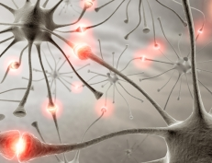
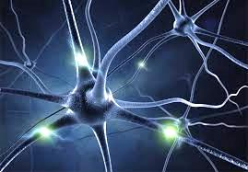
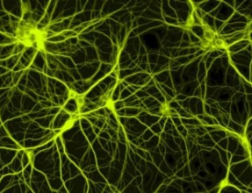
Fleeing from predators
DANGER
FLEE

Slide 14
Representationalism vs. Eliminativism
“There are two major traditions in modern theorizing about the mind, one that we’ll call ‘representationalist’ and one that we’ll call ‘eliminativist.’ Representationalists hold that postulating representational (or ‘intentional’ or ‘semantic’) states is essential to the theory of cognition; according to representationalists, there are states of the mind which function to encode states of the world. Eliminativists, by contrast, think that psychological theories can dispense with such semantic notions as representation. According to eliminativists, the appropriate vocabulary for psychological theorizing is neurological or, perhaps behavioral, or perhaps syntactic; in any event, not a vocabulary that characterizes mental states in terms of what they represent.”
(Fodor & Pylyshin, 1988, p.7)

Slide 15
Representationalism vs. Eliminativism
“There are two major traditions in modern theorizing about the mind, one that we’ll call ‘representationalist’ and one that we’ll call ‘eliminativist.’ Representationalists hold that postulating representational (or ‘intentional’ or ‘semantic’) states is essential to the theory of cognition; according to representationalists, there are states of the mind which function to encode states of the world. Eliminativists, by contrast, think that psychological theories can dispense with such semantic notions as representation. According to eliminativists, the appropriate vocabulary for psychological theorizing is neurological or, perhaps behavioral, or perhaps syntactic; in any event, not a vocabulary that characterizes mental states in terms of what they represent.”
(Fodor & Pylyshin, 1988, p.7)

Slide 16
Representationalism vs. Eliminativism
“There are two major traditions in modern theorizing about the mind, one that we’ll call ‘representationalist’ and one that we’ll call ‘eliminativist.’ Representationalists hold that postulating representational (or ‘intentional’ or ‘semantic’) states is essential to the theory of cognition; according to representationalists, there are states of the mind which function to encode states of the world. Eliminativists, by contrast, think that psychological theories can dispense with such semantic notions as representation. According to eliminativists, the appropriate vocabulary for psychological theorizing is neurological or, perhaps behavioral, or perhaps syntactic; in any event, not a vocabulary that characterizes mental states in terms of what they represent.”
(Fodor & Pylyshin, 1988, p.7)

Slide 17
Two Questions
Question 1: Does the mind really use representations?
Does the mind perform cognitive phenomena via manipulation of internal representations?
Are the entities or states that construct the (relevant) causal structure of the mind individuated by content?
Question 2: Should we use representations in cognitive theorizing?
Is there a role for representations in cognitive explanations?

Slide 18
The Pragmatic Account
Question 1: Does the mind really use representations?
Question 2: Should we use representations in cognitive theorizing?
 | Representationalism | Eliminativism | Pragmatism
Question 1 | Yes | No | No
Question 2 | Yes | No | Yes

Slide 19
The Pragmatic Account
A complete explanation of a cognitive phenomenon is constrained by:
The real-world causal process giving rise to this phenomenon.
The way the explanandum is defined.
This causal process should be definable in non intentional, non-representational terms.
Representations are still necessary in cognitive theorizing.

Slide 20
The Pragmatic Account- Representational Role
Representations do not serve to describe an objective real-world causal structure, but rather to mediate such a structure to us.
Representations serve not to explain what is actually happening in the mind, but rather to explain why whatever it is that is actually happening gives rise to the cognitive phenomena as we choose to define it.

Slide 21
Fleeing from predators
DANGER
FLEE
Theorist

Slide 22
Mental Representations in Cognitive Science

Slide 23
The Importance of Mental Representations
“It has become almost a cliché to say that the most important explanatory posit today in cognitive research is the concept of representation. Like most clichés, it also happens to be true. Since the collapse of behaviorism in the 1950’s, there has been no single theoretical construct that has played such a central role in the scientific disciplines of cognitive psychology, social psychology, linguistics, artificial intelligence, and the cognitive neurosciences. Of course, there have been many different types of representational theories. But all share the core assumption that mental processes involve content-bearing internal states and that a correct account of those processes must invoke structures that serve to stand for something else.” (Ramsey 2007, p. xi)

Slide 24
The Problem
“Yet despite all of this attention (or perhaps because of it), there is nothing even remotely like a consensus on the nature of mental representation. Quite the contrary, the current state of affairs is perhaps best described as one of disarray and uncertainty. There are disagreements about how we should think about mental representation, about why representations are important for psychological and neurological processes, about what they are supposed to do in a physical system, about how they get their intentional content, and even about whether or not they actually exist.” (Ramsey 2007, p. xi)

Slide 25
Chevruta Aims (in my opinion)
Main Aim:
1. To better understand the role of mental representations in different types of cognitive explanations (and in general).
Secondary Aims:
0. To learn about different types of cognitive explanations.
2. To better understand the relations between different types of cognitive explanations.

Slide 26
Method
One theory at a time.
We aim to understand the role of representations in a specific theory or model.
Where are representations used (if at all) in this theory and why?
Do they play an explanatory role? a causal role?
Are the intentional properties really necessary and why?
Do the representations play a causal role in virtue of their content?
What are the justifications for assigning content to these representations?
Can this theory be consistent with an eliminativist approach? A pragmatic approach?

Slide 27
Method
How does the representational role in this theory compare to other instances of representational role?
Can we generalize our conclusions to the role of representations in different types of cognitive explanations?
Does this discussion help us better understand the relations between different cognitive explanations?

